Slide 1

Chapter 2
Information System
Building Blocks
Notes:
This repository of slides is intended to support the named chapter. The slide repository should be used as follows:
Copy the file to a unique name for your course and unit.
Edit the file by deleting those slides you don’t want to cover, editing other slides as appropriate to your course, and adding slides as desired.
Print the slides to produce transparency masters or print directly to film or present the slides using a computer image projector.

Slide 2
Objectives
Differentiate between front- and back-office information systems.
Describe the role of information systems architecture in systems development.
Identify three high-level goals that provide system owners and system users with a perspective of an information system.
Identify three technologies that provide system designers and builders with a perspective of an information system.
Identify three areas of focus for an information system
Notes:
No additional notes

Slide 3
Objectives (cont.)
Describe four building blocks of the KNOWLEDGE goal for an information system.
Describe four building blocks of the PROCESS goal for an information system.
Describe four building blocks of the COMMUNICATIONS goal for an information system.
Describe the role of network technologies as it relates to Knowledge, Processes, and Communications building blocks.
Notes:
No additional notes

Slide 4
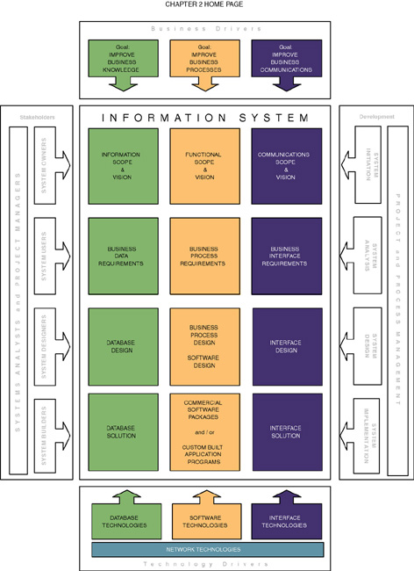
Notes:
Teaching Notes
This is the capstone figure for the chapter—the complete information systems building blocks framework.
Emphasize that ALL building blocks are relevant to ALL information systems that the student will encounter or develop during the course of their career.
Emphasize that the building blocks must be synchronized both horizontally and vertically when building information systems.
Vertical synchronization ensures that each block represents fully the perspectives of the other blocks in the same column. For example, a database schema must implement the intended data requirements.
Horizontal synchronization ensures that each block in a given row is consistent and complete with respect to the other blocks in that same row. For example, each table in a database schema requires application software and specifications to maintain the data stored in those tables.

Slide 5
Front- and Back-Office
Information Systems
Front-office information systems support business functions that extend out to the organization’s customers (or constituents).
  Marketing
  Sales
  Customer management
Back-office information systems support internal business operations of an organization, as well as reach out to suppliers (of materials, equipment, supplies, and services).
  Human resources
  Financial management
  Manufacturing
  Inventory control
Notes:
Teaching Notes
This classification scheme comes from popular usage in the trade literature.
This terminology is not to be confused with office automation. In fact, office automation systems can be either front-office or back-office, just as with other types of information system applications.

Slide 6
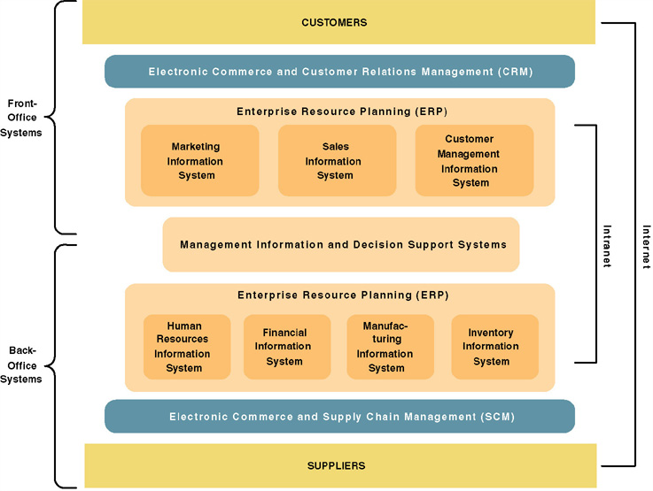
A Federation of
Information Systems
Notes:
Teaching Notes
This slide visually illustrates front- and back-office applications and highlights the following:
Many organizations purchase their back-office systems in the form of enterprise resource planning (ERP) products such as SAP, PeopleSoft, and Oracle.
The ERP industry is trying to expand into the front-office applications.
It might be noted that electronic commerce and business extensions are being added to both front- and back-office applications in order to streamline interfaces to both customers and suppliers.
E-commerce is being driven by the Internet (and private extranets).
E-business is being enabled by intranets.

Slide 7
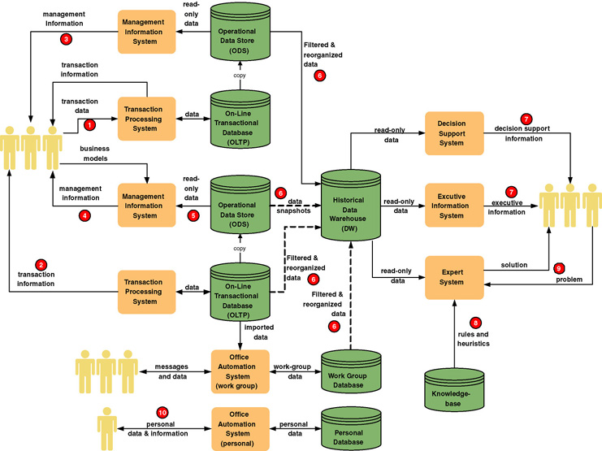
Information System Applications
Notes:
Teaching Notes
It may be useful to walk through this diagram in class. The textbook coverage included numbered annotations that highlight portions of this diagram.
Remind students that any given information system may include many instances of each of these IS application processes and databases.

Slide 8
Information Systems Architecture
Information systems architecture - a unifying framework into which various stakeholders with different perspectives can organize and view the fundamental building blocks of information systems.
Notes:
Teaching Notes
If you did not cover chapter 1, you will want to define stakeholder here.
The rest of the chapter will be spent looking at an information system architecture.

Slide 9
High-Level Goals of
System Owners and System Users
Improve business knowledge
Improve business processes and services
Improve business communication and people collaboration
Notes:
Teaching Notes
It may be useful to contrast the goals of system owners and system users with the perspectives of system designers and system builders shown on the next slide. System owners and users are not overly interested in technologies, but they are keenly interested in things that accomplish these goals.

Slide 10
Technology Perspectives of
System Designers & System Builders
Database technologies that support business accumulation and use of business knowledge
Software technologies that automate and support business processes and services
Interface technologies that support business communication and collaboration
Notes:
Teaching Notes
See notes on the prior slide. If your students have sufficient experience, you could illustrate each of these technologies, such as:
Database – Oracle
Software – Java
Interface – HTML

Slide 11
Focuses for Information Systems
Knowledge — the raw material used to create useful information.
Process — the activities (including management) that carry out the mission of the business.
Communication — how the system interfaces with its users and other information systems.
Notes:
Teaching Notes
Make sure students make the connection between the three points on this slide and the three points on each of the prior two slides.

Slide 12
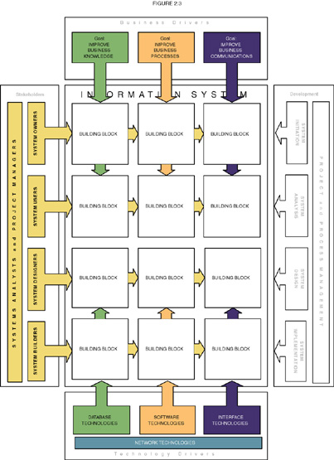
Information System Building Blocks
Notes:
Teaching Notes
This slide serves to establish the focus for the chapter. The highlighted cells are the information system building blocks that are described in detail as this chapter unfolds.

Slide 13
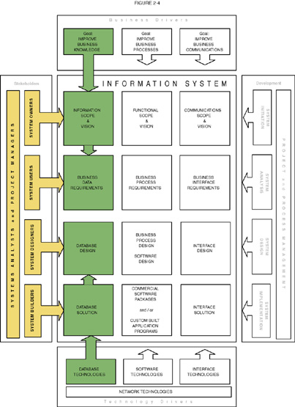
KNOWLEDGE Building Blocks
Notes:
Teaching Notes
This slide visually illustrates the chapter’s discussion of the KNOWLEDGE focus as seen by different stakeholders.
If your students have taken a database course, it can be useful to summarize that experience within the context of the KNOWLEDGE column.

Slide 14
Views of KNOWLEDGE
System owners’ view
  Interested not in raw data but in information that adds new business knowledge and helps managers make decisions.
  Business entities and business rules.
System users’ view
  View data as something recorded on forms, stored in file cabinets, recorded in books and spreadsheets, or stored on computer.
  Focus on business issues as they pertain to data.
  Data requirement – a representation of users’ data in terms of entities, attributes, relationships, and rules independent of data technology.
Notes:
Teaching Notes
This slide places definitions and key terms relevant to the KNOWLEDGE focus into the context of stakeholders.

Slide 15
Views of KNOWLEDGE (cont.)
System designers’ view
  Data structures, database schemas, fields, indexes, and constraints of particular database management system (DBMS).
System builders’ view
  SQL
  DBMS or other data technologies
Notes:
Teaching Notes
This slide places definitions and key terms relevant to the KNOWLEDGE focus into the context of stakeholders.

Slide 16
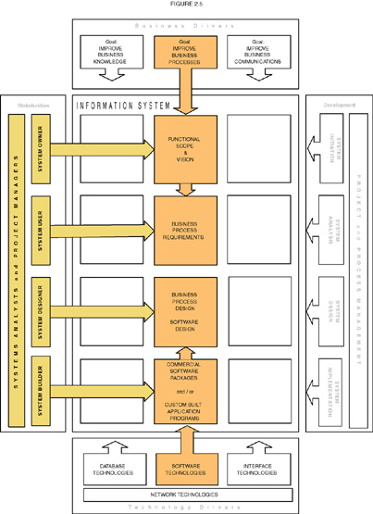
PROCESS Building Blocks
Notes:
Teaching Notes
This slide visually illustrates the chapter’s discussion of the PROCESS focus as seen by the different stakeholders.
Most students have some programming experience. Accordingly, it can be useful to summarize that experience within the context of the PROCESS column. Consider summarizing that experience by working bottom-to-top in the column to reinforce their perspective of the “application programs” they wrote.
The programming instructor typically played the roles of system owners, users, and analysts when they wrote the programming assignments.
The student typically played the roles of designer (e.g., flowcharts) and builder (e.g, programming code).

Slide 17
Views of PROCESS
System owners’ view
  Concerned with high-level processes called business functions.
  Business function – a group of related processes that support the business. Functions can be decomposed into other subfunctions and eventually into processes that do specific tasks.
  A cross-functional information system – a system that supports relevant business processes from several business functions without regard to traditional organizational boundaries such as divisions, departments, centers, and offices.
Notes:
Teaching Notes
This slide places definitions and key terms relevant to the PROCESS focus into the context of stakeholders.

Slide 18
Views of PROCESS (cont.)
System users’ view
  Concerned with work that must be performed to provide the appropriate responses to business events.
  Business processes – activities that respond to business events.
  Process requirements – a user’s expectation of the processing requirements for a business process and its information systems.
  Policy – a set of rules that govern a business process.
  Procedure – a step-by-step set of instructions and logic for accomplishing a business process.
  Work flow – the flow of transactions through business processes to ensure appropriate checks and approvals are implemented.
Notes:
Teaching Notes
This slide places definitions and key terms relevant to the PROCESS focus into the context of stakeholders.

Slide 19
Views of PROCESS (cont.)
System designers’ view
  Concerned with which processes to automate and how to automate them
  Constrained by limitations of application development technologies being used
  Software specifications – the technical design of business processes to be automated or supported by computer programs to be written by system builders.
Notes:
Teaching Notes
This slide places definitions and key terms relevant to the PROCESS focus into the context of stakeholders.

Slide 20
Views of PROCESS (cont.)
System builders’ view
  Concerned with programming logic that implements automated processes
  Application program – a language-based, machine-readable representation of what a software process is supposed to do, or how a software process is supposed to accomplish its task.
  Prototyping – a technique for quickly building a functioning, but incomplete model of the information system using rapid application development tools.
Notes:
Teaching Notes
This slide places definitions and key terms relevant to the PROCESS focus into the context of stakeholders.

Slide 21
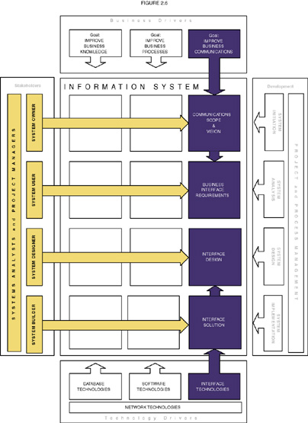
COMMUNICATION Building Blocks
Notes:
Teaching Notes
This slide visually illustrates the chapter’s discussion of the COMMUNICATION focus as seen by the different stakeholders.
Many students have written programs for graphical user interfaces using languages such as Access, Visual Basic and HTML. Accordingly, it can be useful to summarize that experience within the context of the INTERFACE column.
While it is conceptually and practically useful to separate COMMUNICATION and PROCESS, it should be noted that many of today’s contemporary application development environments (ADEs) such as .NET effectively integrate the technology used to construct both the user interface and the application logic. Some students find this confusing.
Interestingly, the emphasis on Web-based applications is truly separating the concerns. For example, the interface elements of a Web are written in HTML while the application logic is written in C# or Java.

Slide 22
Views of COMMUNICATION
System owners’ view
  Who (which business units, employees, customers, and partners) must interact with the system?
  Where are these business units, employees, customers, and partners located?
  What other information systems will the system have to interface with?
System users’ view
  Concerned with the information system’s inputs and outputs.
Notes:
Teaching Notes
This slide places definitions and key terms relevant to the COMMUNICATION focus into the context of stakeholders.

Slide 23
Views of COMMUNICATION (cont.)
System designers’ view
  Concerned with the technical design of both the user and the system-to-system communication interfaces.
  Interface specifications – technical designs that document how system users are to interact with a system and how a system interacts with other systems.
  User dialogue – a specification of how the user moves from window to window or page to page, interacting with the application programs to perform useful work.
Notes:
Teaching Notes
This slide places definitions and key terms relevant to the COMMUNICATION focus into the context of stakeholders.

Slide 24
Views of COMMUNICATION (cont.)
System builders’ view
  Concerned with the construction, installation, testing and implementation of user and system-to-system interface solutions.
  Middleware – utility software that allows application software and systems software that utilize differing technologies to interoperate.
Notes:
Teaching Notes
This slide places definitions and key terms relevant to the COMMUNICATION focus into the context of stakeholders.

Slide 25
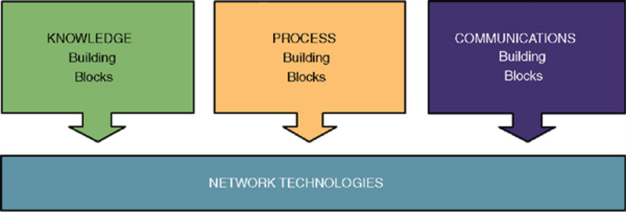
Network Technologies and the
IS Building Blocks
Clean-layering approach allows any one building block to be replaced with another while having little or no impact on the other building blocks
Notes:
Teaching Notes
This slide illustrates the classic model of separating and partitioning the layers of an information system application across a network.
This clean-layering approach allows any one building block to be replaced with another while having little or no impact on the other building blocks.
This is called a distributed computing architecture and it can be implemented using either client/server or Internet/intranet technology, or a combination of both.

